Slide 1
Introduction to TensorFlow
Noble Xavier

Slide 2
DEEP LEARNING

Slide 3
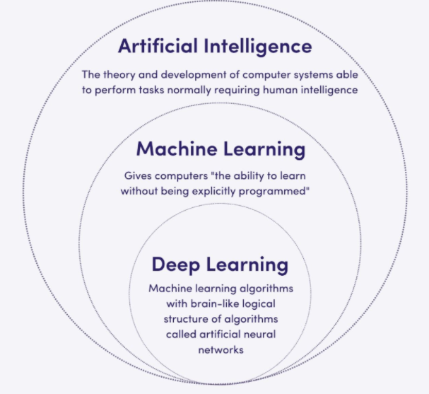
Deep Learning
Deep learning is a type of machine learning that uses artificial neural networks to process data and learn from examples

Slide 4
Deep Learning
How it works | Uses neural networks with multiple layers to process data
What it can do | Recognize patterns, make predictions, and solve complex problems
What it's used for | Image recognition, speech recognition, natural language processing, and more
How it's different from traditional machine learning | More accurate, autonomous, and can process more types of data
Examples | ChatGPT, Bard, Bing Chat, Midjourney, and DALL-E

Slide 5
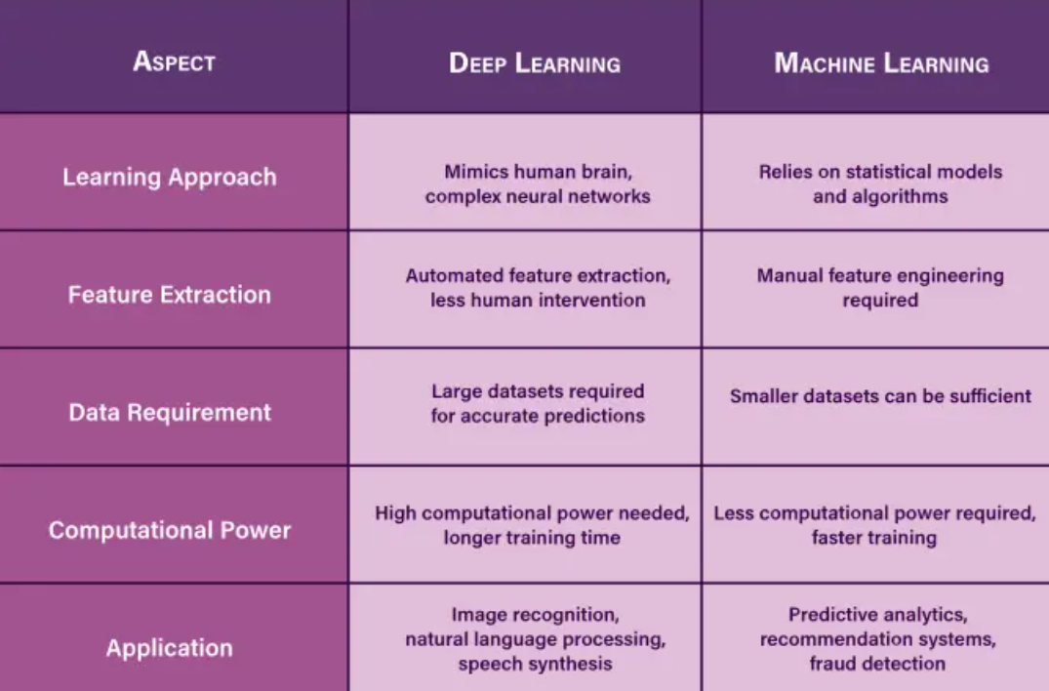
Difference Between Machine Learning and Deep Learning

Slide 6
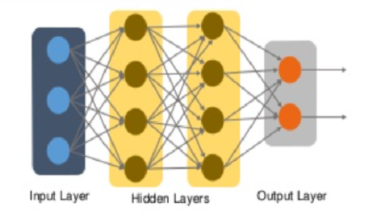
Structure of Deep Learning
Deep Learning is a subset of Machine Learning and it works on the structure and functions of a human brain.
It learns from data that is unstructured and uses complex algorithms to train a neural net.

Slide 7
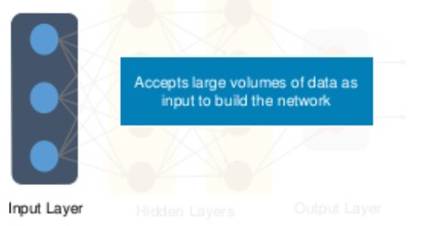
Deep Learning- Input Layer
In deep learning, the input layer is the first layer in a neural network that receives raw input data, like images, text, or audio, and transforms it into a format the network can understand

Slide 8
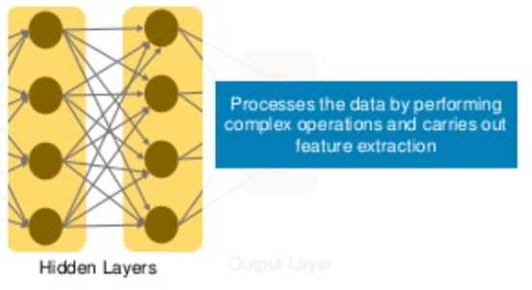
Deep Learning- Hidden Layer
In deep learning, hidden layers are the intermediary layers within a neural network, situated between the input and output layers.
These layers are responsible for processing the input data and transforming it into a more complex, learnable representation.

Slide 9
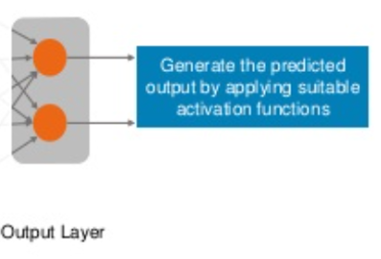
Deep Learning- Output Layer
In deep learning, the output layer is the final layer of a neural network, responsible for producing the network's predictions or classifications.
It receives processed data from the preceding hidden layers and transforms it into a final output suitable for interpretation

Slide 10
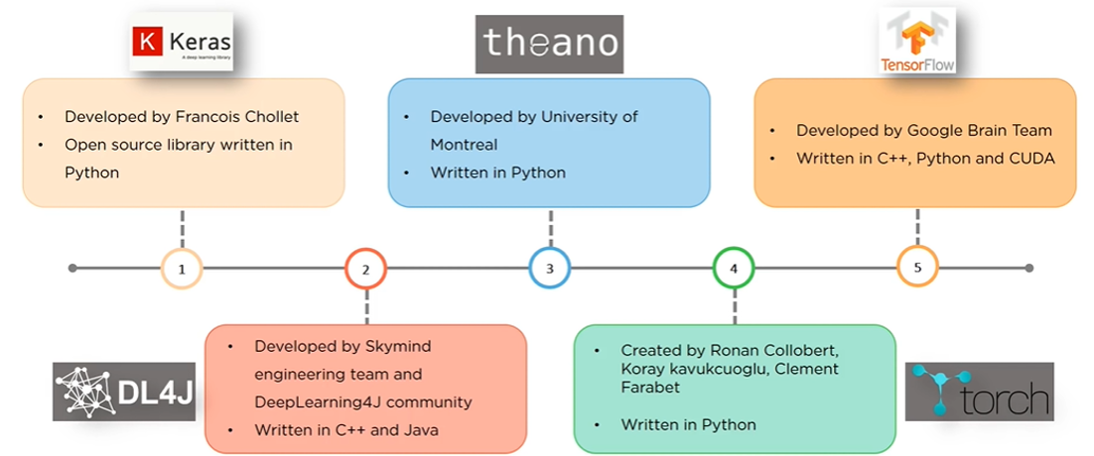
Top Deep Learning Libraries

Slide 11
TENSORFLOW

Slide 12
What is TensorFlow
TensorFlow is an open-source platform and framework for machine learning and deep learning developed by Google.
It's used to build and train machine learning models, particularly deep neural networks, for a wide range of applications.
TensorFlow is a flexible framework that can be used on various hardware, including CPUs, GPUs, and TPUs.

Slide 13
Key Features
Deep Learning Focus : TensorFlow is well-suited for building and training deep neural networks,
Flexibility:It can be used with various programming languages, including Python, C++, and Java, and runs on different hardware, making it adaptable for diverse needs
Open Source: TensorFlow is open-source, meaning it is freely available for use and modification by anyone.
Large-Scale Applications:TensorFlow is designed for handling large datasets and complex models, making it suitable for large-scale machine learning projects.
Keras Integration:TensorFlow integrates well with Keras, a high-level API that simplifies model building and training, making it easier for beginners to get started with deep learning.

Slide 14
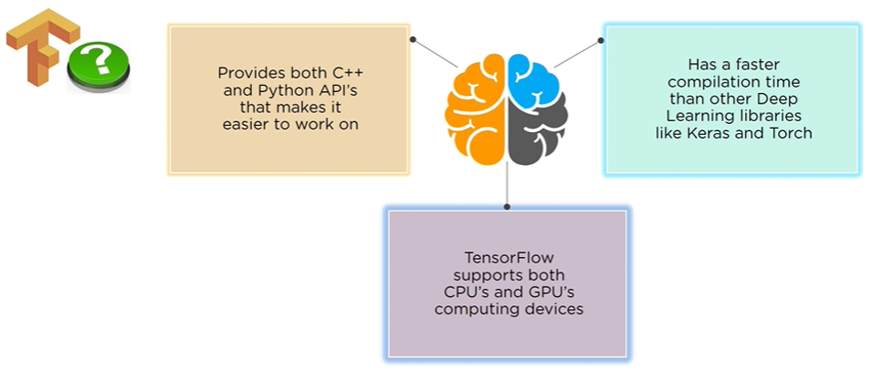
Why TensorFlow

Slide 15
Differences Keras and Tensor Flow
Keras is a high-level API for building and training neural networks, while TensorFlow is a low-level machine learning framework.
Keras is designed for ease of use and rapid prototyping, whereas TensorFlow provides more control and flexibility for complex tasks.
Keras operates on top of TensorFlow .In essence, using Keras means indirectly using TensorFlow

Slide 16
Differences Keras and Tensor Flow
Feature | Keras | TensorFlow
Level of API | High-level | Low-level
Ease of Use | User-friendly, simple syntax | More complex, steeper learning curve
Flexibility | Less flexible, designed for common tasks | Highly flexible, allows for custom implementations
Speed | Comparatively slower for large datasets | Optimized for high performance and speed
Debugging | Easier to debug simple networks | Debugging can be more challenging
Dataset Size | Better suited for smaller datasets | Handles large datasets efficiently
Use Cases | Rapid prototyping, simple models | Complex models, large-scale applications

Slide 17
TENSORS

Slide 18
What is Tensors
In deep learning, tensors are fundamental, multidimensional arrays used to represent and manipulate data, including images, text, and numerical values, during both training and inference.
Examples:
A scalar (a single number) is a 0-dimensional tensor.
A vector (an array of numbers) is a 1-dimensional tensor.
A matrix (a 2D array) is a 2-dimensional tensor.
An image can be represented as a 3D tensor (height, width, color channels).
A batch of images can be represented as a 4D tensor (batch size, height, width, color channels).

Slide 19
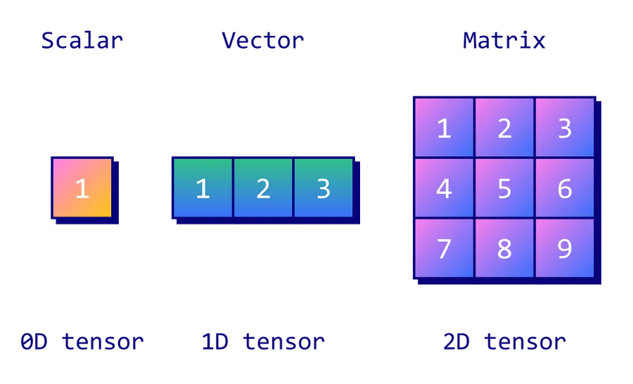
What is Tensors

Slide 20
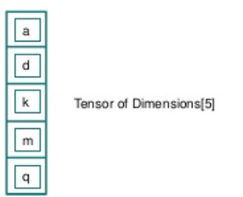
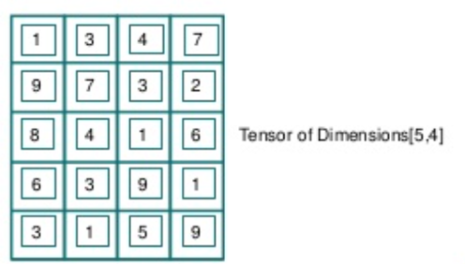
What is Tensors

Slide 21
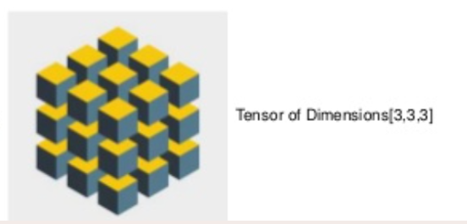
What is Tensors

Slide 22
Tensor Ranks
In the context of tensors, "rank" or "order" refers to the number of axes or dimensions needed to describe it
Zero-Rank Tensor (Scalar)
First-Rank Tensor (Vector)
Second-Rank Tensor (Matrix)
Higher-Rank Tensors:As the rank increases, tensors can represent quantities with more complex relationships in higher dimensions, requiring more axes to define them. For example, a 3rd-rank tensor can be thought of as a cube of numbers.

Slide 23
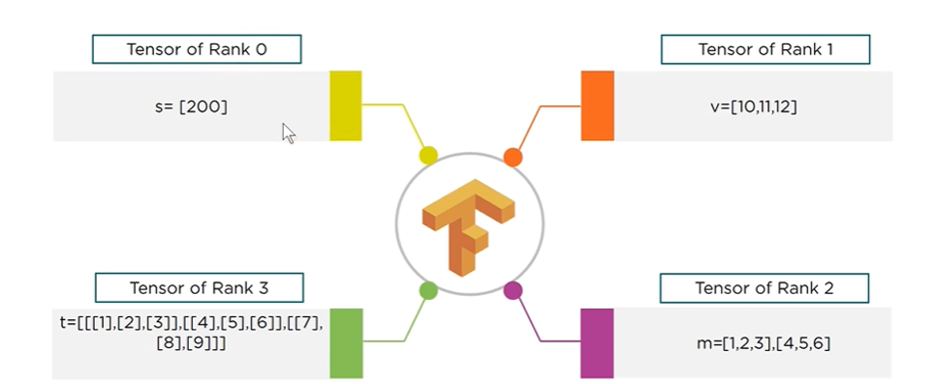
Tensor Ranks

Slide 24
DATA FLOW GRAPHS

Slide 25
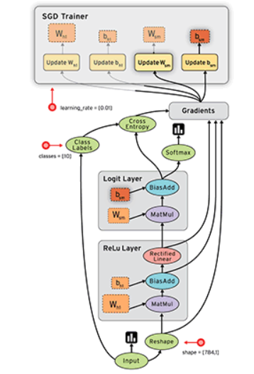
Data Flow Graph
A Data Flow Graph (DFG) is a visual representation that depicts the flow of data through a system, process, or program, showing how data is processed and transformed.
Key Concepts:
Nodes (Actors): Represent operations, functions, or modules that process data.
Arcs (Links): Show the flow of data between nodes, indicating which node's output becomes another node's input.
Data Flow: The movement of data through the graph, highlighting how data is transformed or modified as it passes through different nodes.

Slide 26
Data Flow Graph
Each computation in TensorFlow is represented as a Data Flow Graph.
Each node in the graph represents a mathematical operation (add, subtract, multiply, etc), and each edge represents multidimensional arrays (Tensors).
Computational Graph is the graph of programming logic which TensorFlow builds in memory.
Enables creating large-scale neural networks as computing can be distributed across several CPUs or GPU’s

Slide 27
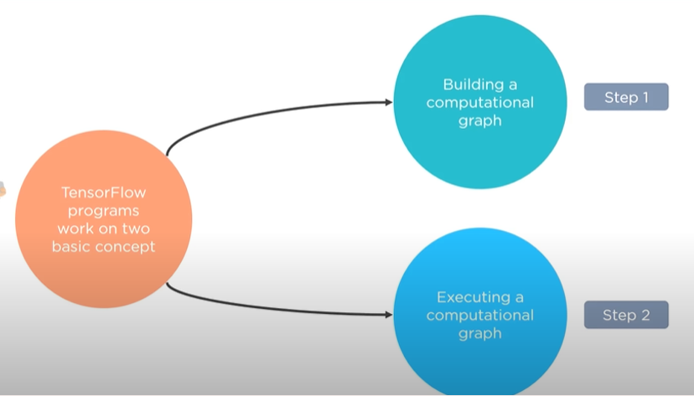
Program Elements in TensorFlow
Program Elements in TensorFlow: TensorFlow programs work on two basic concepts
Building a computational graph
Executing a computational graph

Slide 28

Program Elements in TensorFlow
Multi-Dimensional Arrays
A Graph of Operations

Slide 29
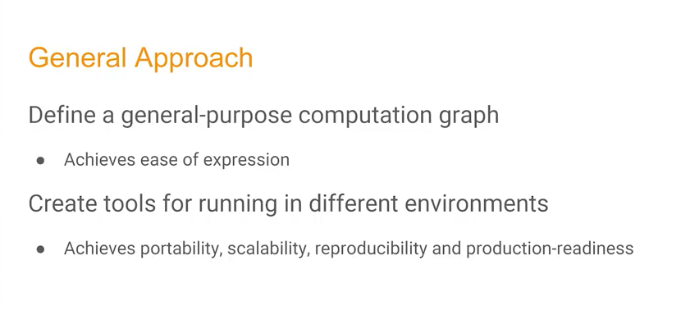

Slide 30
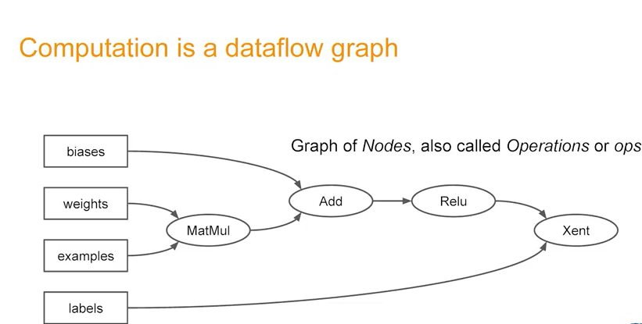

Slide 31
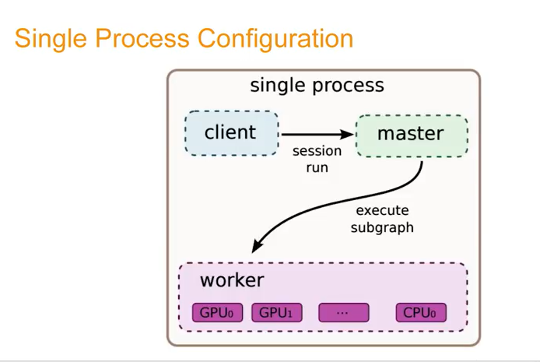

Slide 32
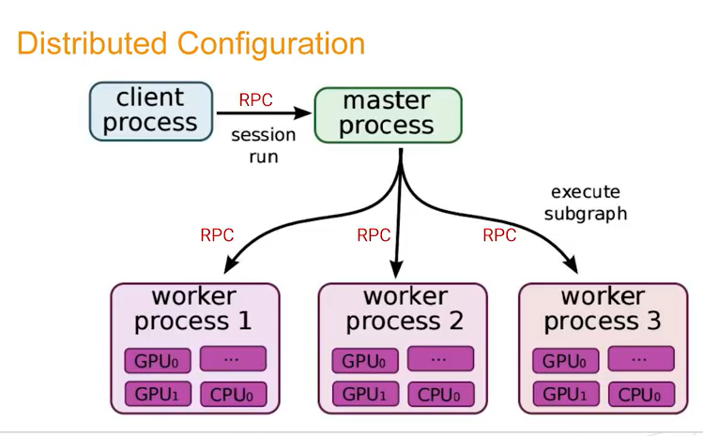

Slide 33
Program Elements in TensorFlow – Constants
Constants are parameters whose value does not change. To define a constant, we use tf.constant() command.
Example
  a = tf.constant(2.0, tf.float32)
  b = tf.constant(3.0)
  print(a, b)
  sess = tf.Session()
  print (sess.run(a),sess.run(a))

Slide 34
Program Elements in TensorFlow – Place Holder
Placeholders allow us to feed data to a TensorFlow model from outside a model.
It permits a value to be assigned later.
To define a placeholder, we use tf.placeholder() command.
Example:
  a = tf.placeholder(tf.float32)
  b = a*2
  with tf.Session() as sess:
  result = sess.run(b,feed_dict={a:3.0})
  print result
feed_dict specifies tensors that provide concrete values to the placeholders

Slide 35
Program Elements in TensorFlow- Variables
Variables allow us to add new trainable parameters to the graph.
To define a variable, we use tf. Use the Variable() command to initialise variables before running the graph in a session.
Example:
  W = tf.Variable([.3],dtype=tf.float32)
  b = tf.Variable([-.3],dtype=tf.float32)
  x = tf.Placeholder(tf.float32)
  linear_model = W*x+b

Slide 36
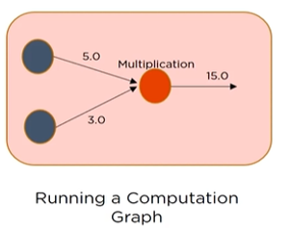
Program Elements in TensorFlow-Session
A session is run to evaluate the nodes. This is called the TensorFlow runtime.
Example:
  a = tf.constant(5.0)
  b = tf.constant(3.0)
  c = a*b
# Launch Session
  sess = tf.Session()
# Evaluate the tensor c
  print(sess.run(c))

Slide 37
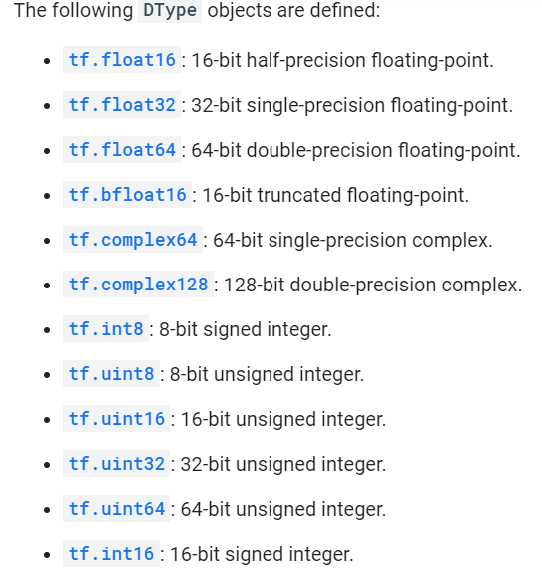
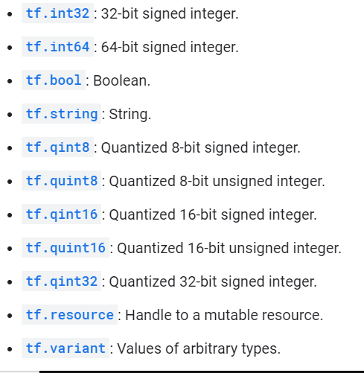
Data Types

Slide 38
TensorFlow object types
TensorFlow employs several key object types to manage and manipulate data within its computational graphs.
These object types work together to enable the construction, execution, and training of machine learning models within the TensorFlow framework.
These include
Tensors:
Tensors are the fundamental data structure in TensorFlow, representing multi-dimensional arrays.
They can hold data of various types, such as integers, floating-point numbers, or strings.
Variables:
Variables are used to store and update parameters within a TensorFlow model during training

Slide 39
TensorFlow object types
Placeholders:
Placeholders act as stand-ins for input data that will be fed into the graph at runtime. They allow the construction of the computational graph independently of the actual data.
Operations (Ops):
Operations represent computations performed on tensors. Examples include addition, multiplication, and matrix operations.
Graphs:
A TensorFlow graph is a representation of the entire computation, consisting of interconnected nodes (operations) and edges (tensors). It defines the sequence of operations to be performed.
Datasets:
The Dataset API provides a way to represent and manipulate large datasets efficiently. It allows for operations like batching, shuffling, and mapping functions over the data.

Slide 40
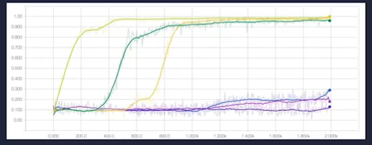
Tensor Board
Tensor Board is a web-based visualization toolkit for TensorFlow and other machine learning frameworks that allows users to inspect and understand their models and training process.

